Slide 1
Overview - History of the Field Band
History:
-To the Army: tradition, esprit de corps, lessons learned
“We live in community, in a continuum of time, connected to a legacy of thought. It is like witnessing a very long conversation with many members from the beginning of time.”
- Therese Cooley

Slide 2
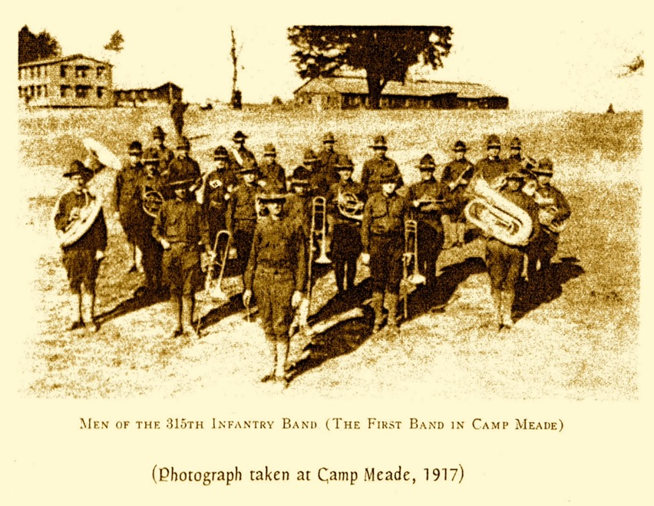
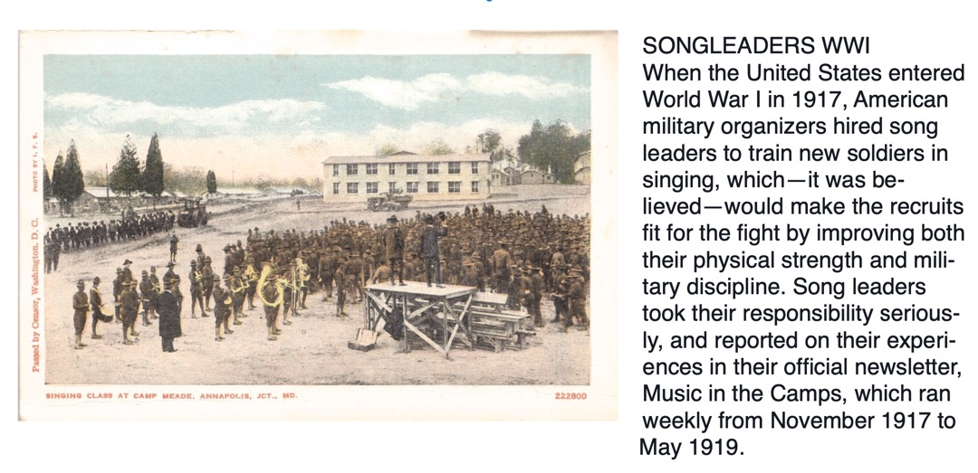
1917: Camp Meade, MD is established.
(In 1928 it is briefly named “Ft. Leonard Wood,” and then “Ft. George G. Meade,” to differentiate it from the existing Ft. Meade in South Dakota -- which is now a VA hospital!)
As troops pass through and train for World War I, Camp Meade is home to many bands of all sizes.

Slide 3
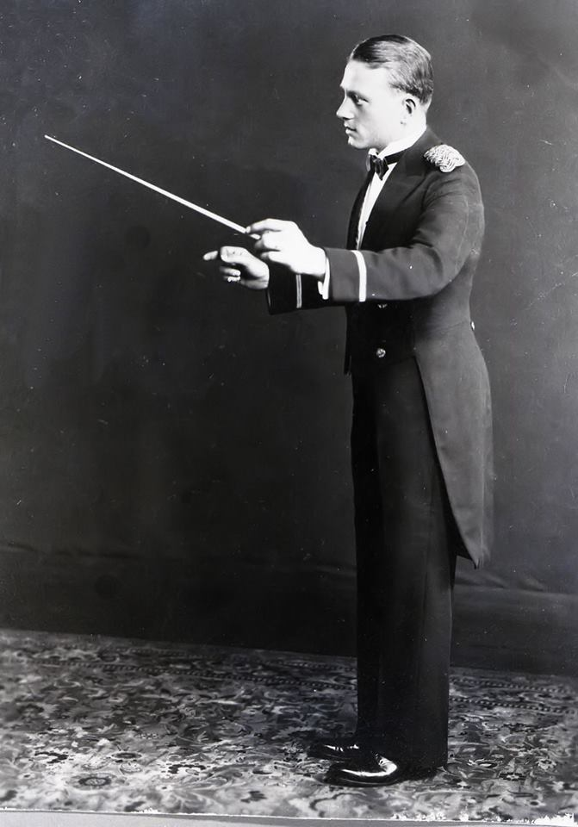
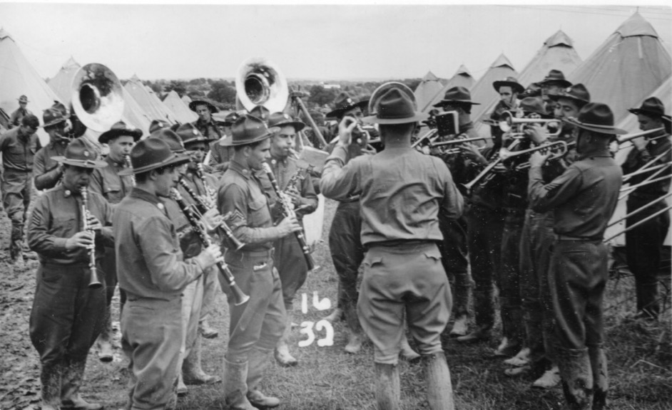
1920s-1930s: Future founding members of the Field Band:
Chester “Chet” Whiting and the 110th Mounted Cavalry Band, Massachusetts National Guard.

Slide 4
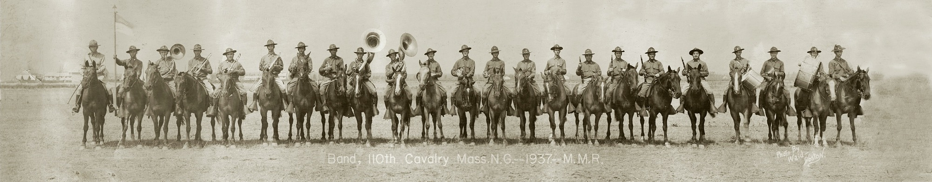

Slide 5
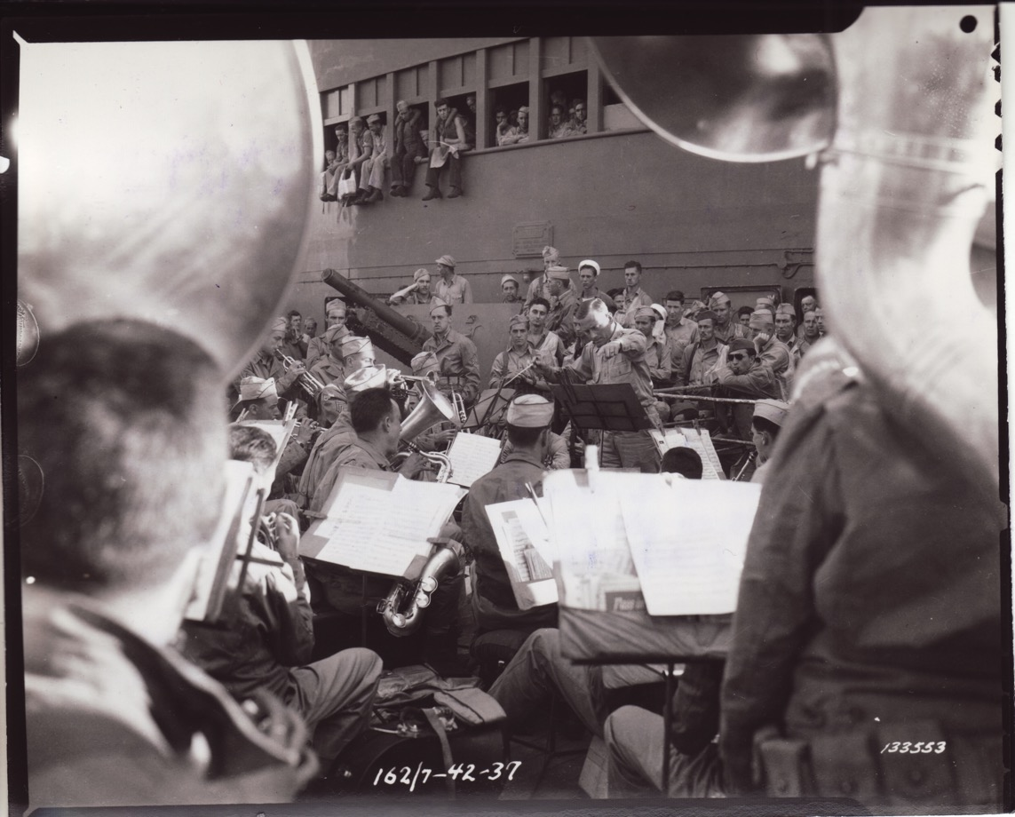
WWII: Whiting and the 110th travel via ship to the Pacific Theater (1941-1944)
They form the Americal Division Band, and perform and see combat on
New Caledonia, Fiji, Guadalcanal, and Bougainville.

Slide 6
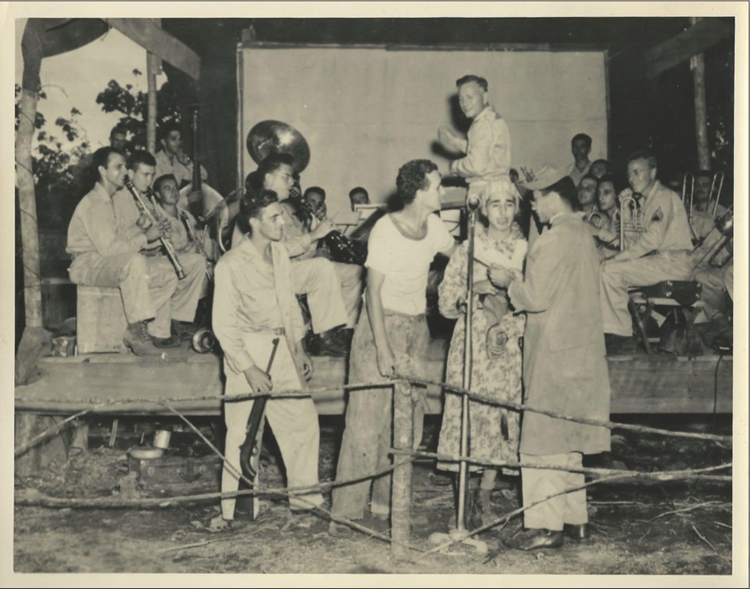
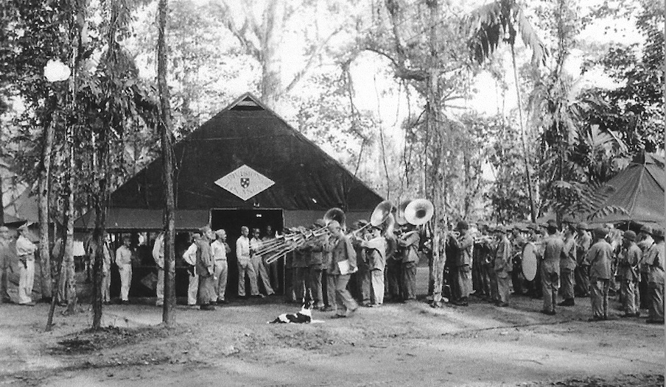
Despite war and terrible living conditions, Whiting and the Americal Division Band compose and arrange music, travel and perform extensively, and are a very effective morale builder. They make an impression on Army leadership…

Slide 7
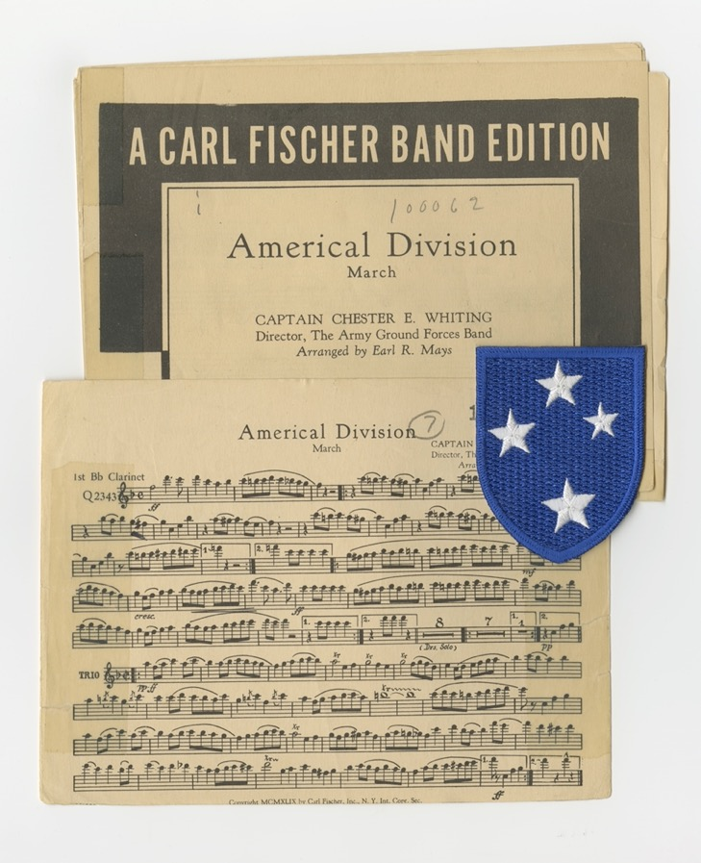

Slide 8
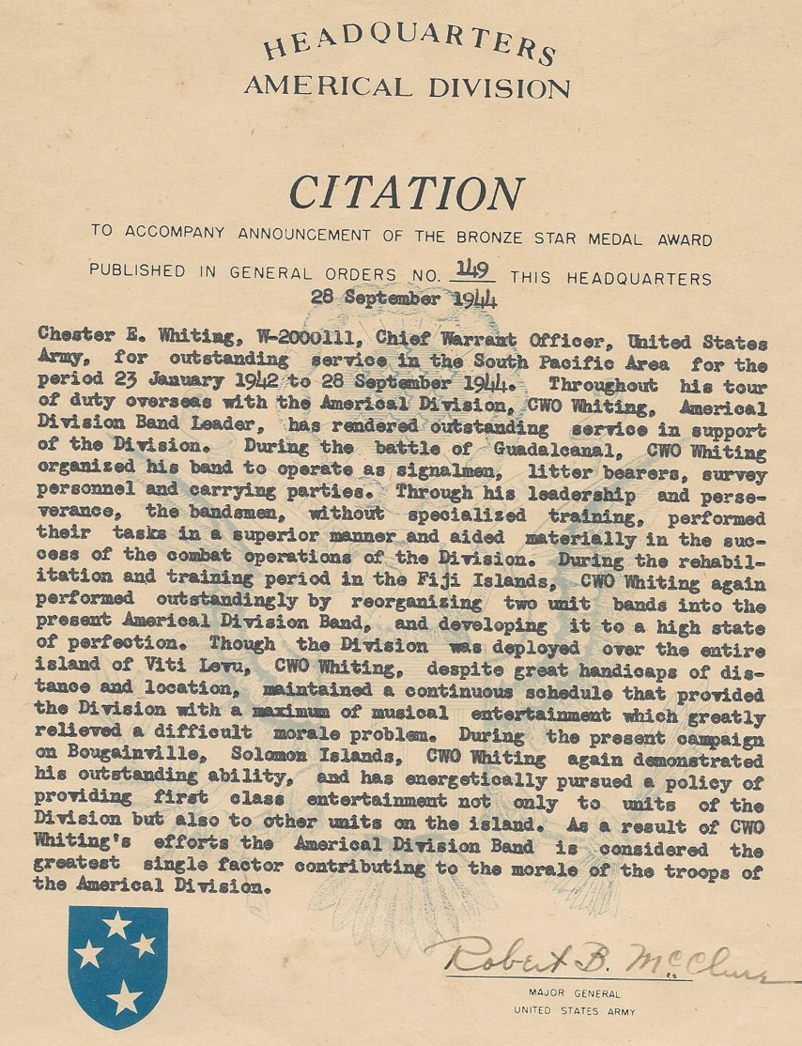

Slide 9
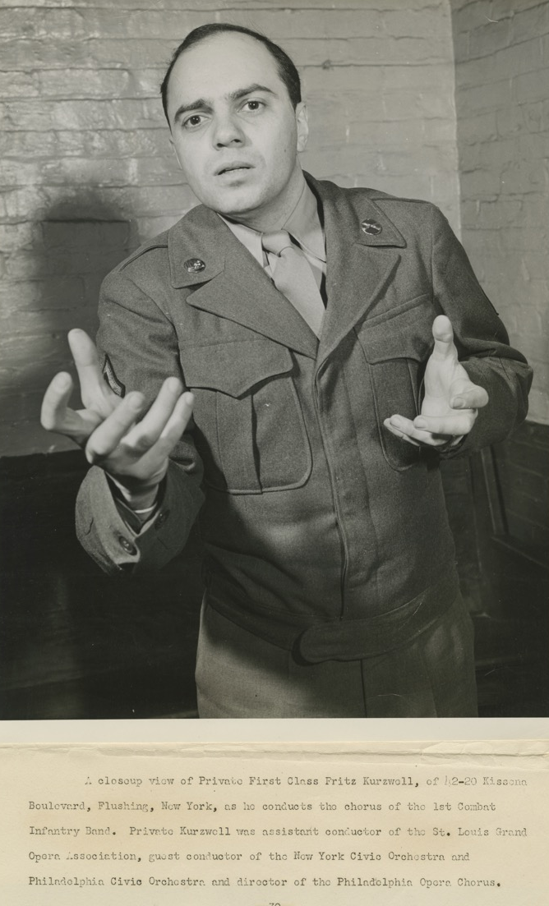
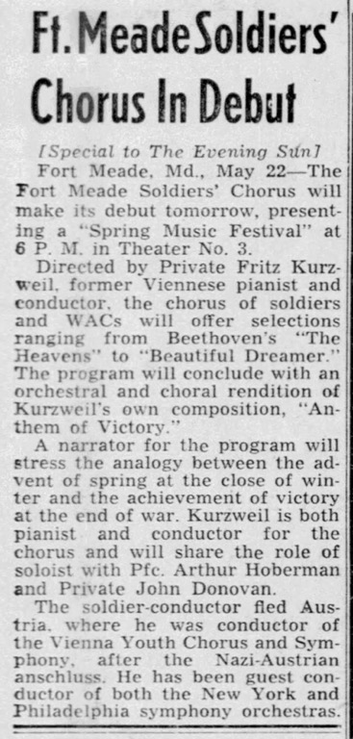
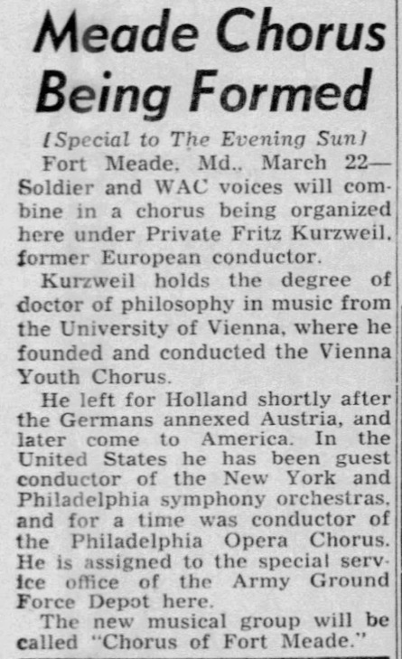
MEANWHILE, conductor, composer, arranger, and pianist Fritz Kurzweil narrowly escapes Nazi controlled Vienna, comes to the United States, joins the Army, and founds the Ft. Meade mixed chorus, AKA Ft. Meade soldiers’ chorus.

Slide 10
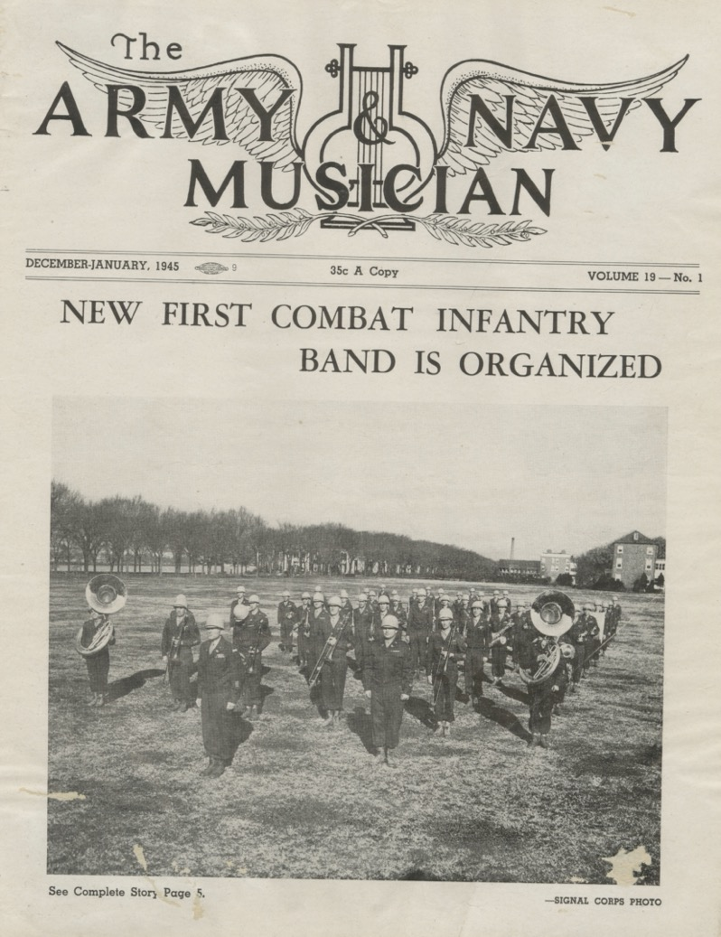
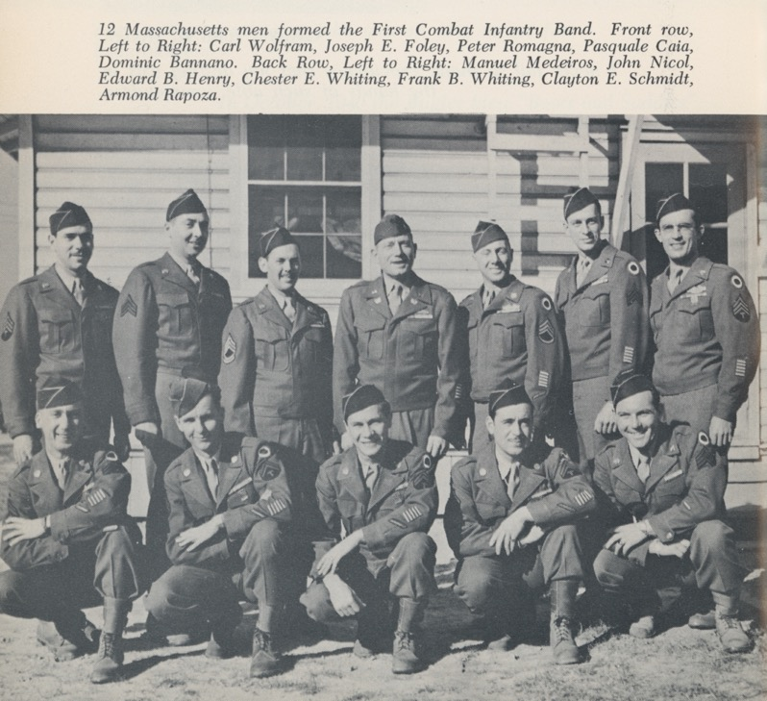
1944: Whiting and the “Massachusetts men” return to the United States. Whiting is put in command of a new band, the 1st Combat Infantry Band (FCIB) at Ft. Meade, which tours the US in support of the continuing war effort. The band is made up entirely of combat veterans.

Slide 11
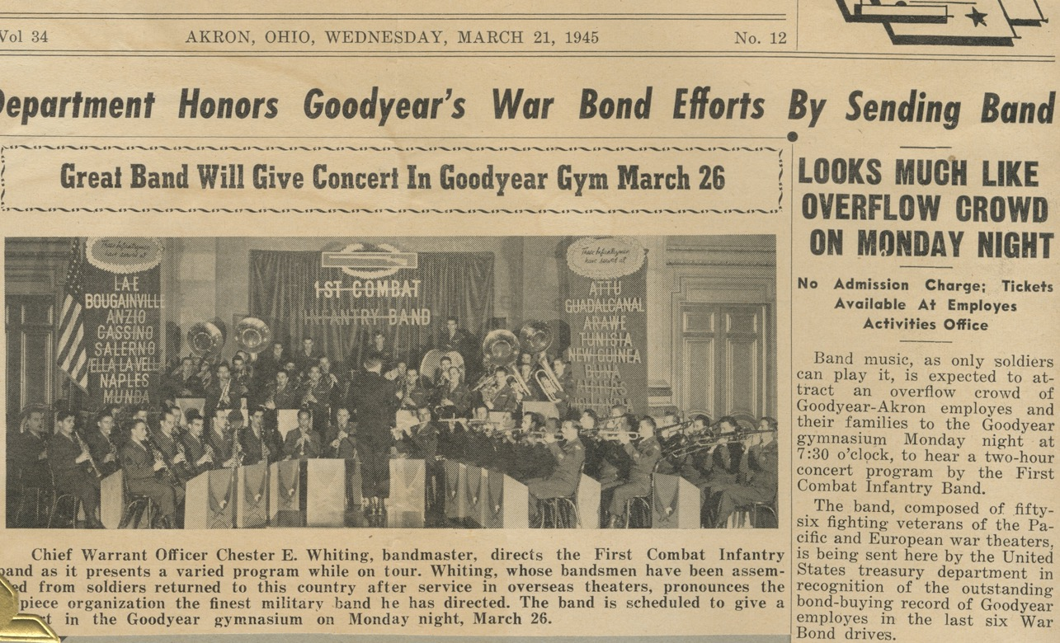
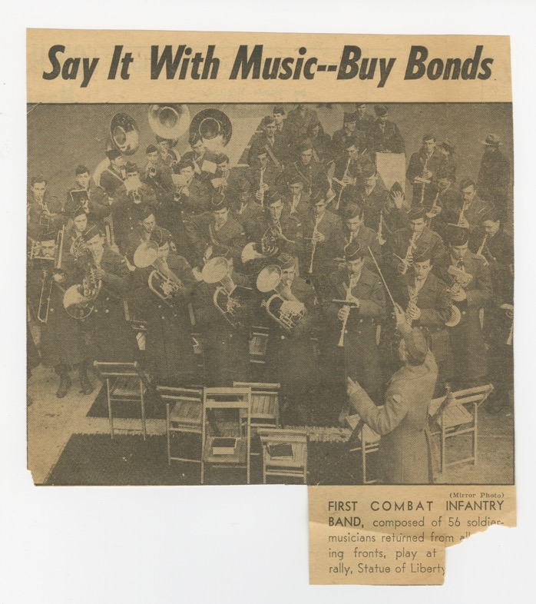

Slide 12
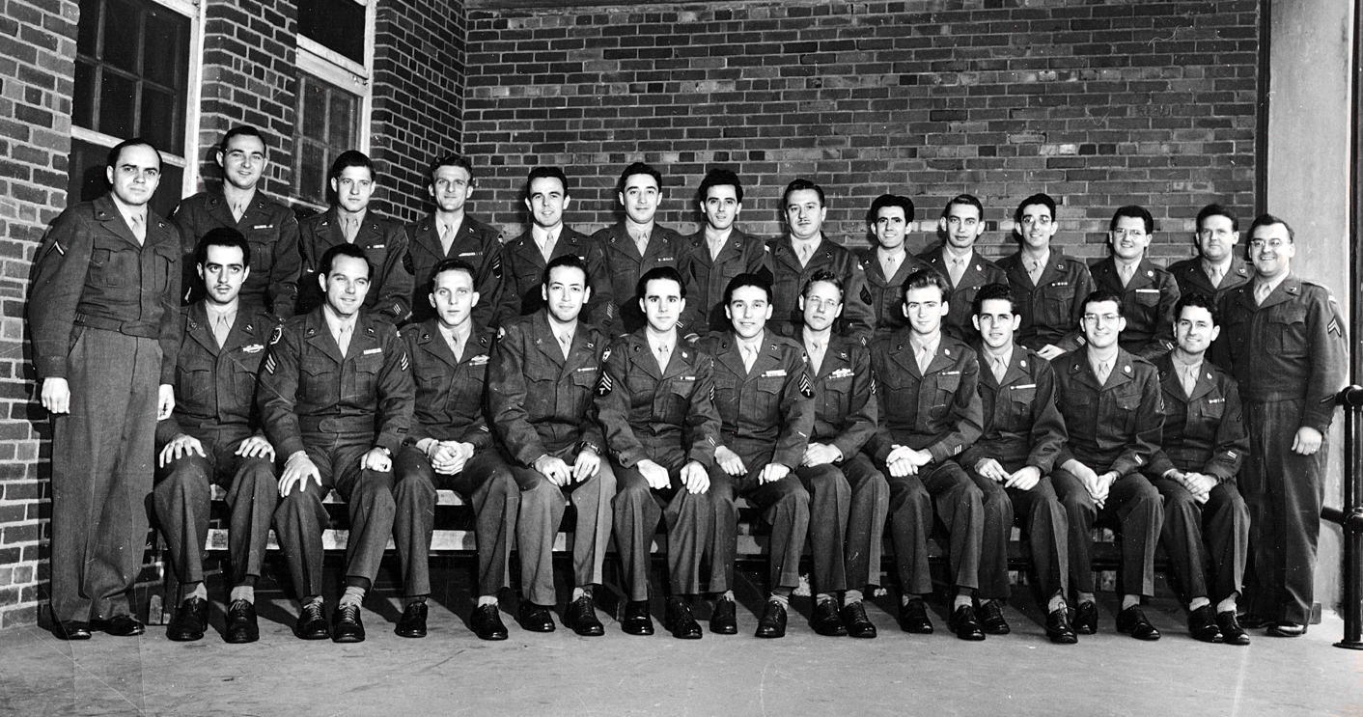
1944: At Ft. Meade, Whiting links up with Fritz Kurzweil, who becomes part of the FCIB as conductor, composer, arranger, piano soloist – and most importantly, choral director. A chorus is formed of instrumentalists and is part of every performance.

Slide 13
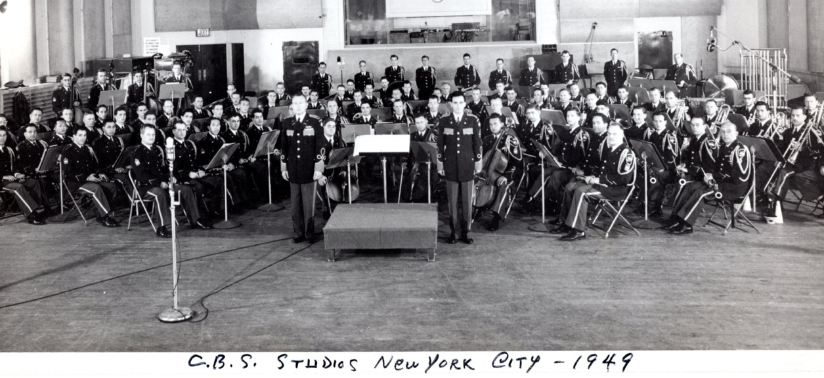
1946: WWII ends and General Jacob Devers puts Whiting in charge of a permanent, new Army Special Band: The Army Ground Forces Band – giving them a specific mission statement, “Go out into the grassroots of America and tell the story of the American Ground Soldier…”
The new band is essentially the same band as the 1st Combat Infantry Band (same commander, duty station, and personnel) but with an updated mission statement.
It continues touring the US – now with the mission of keeping Americans and the Army connected.

Slide 14
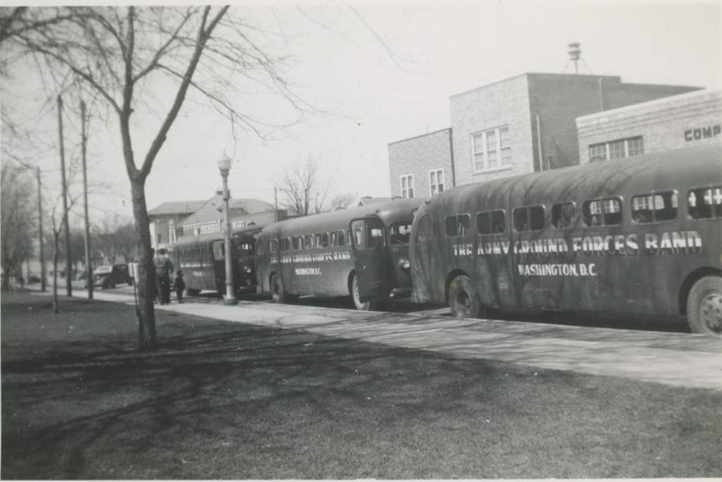
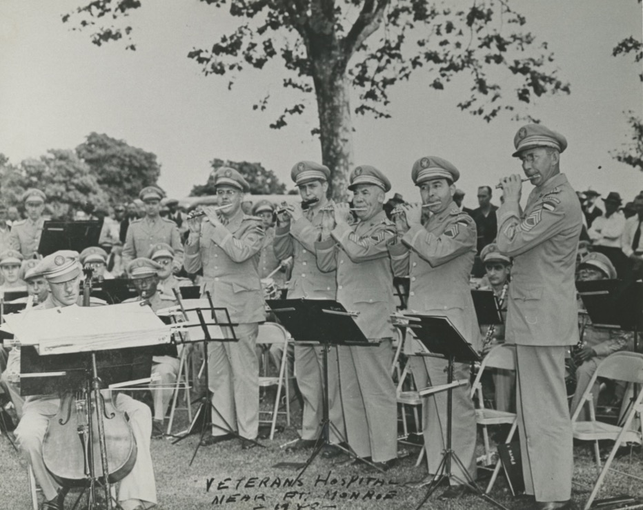

Slide 15
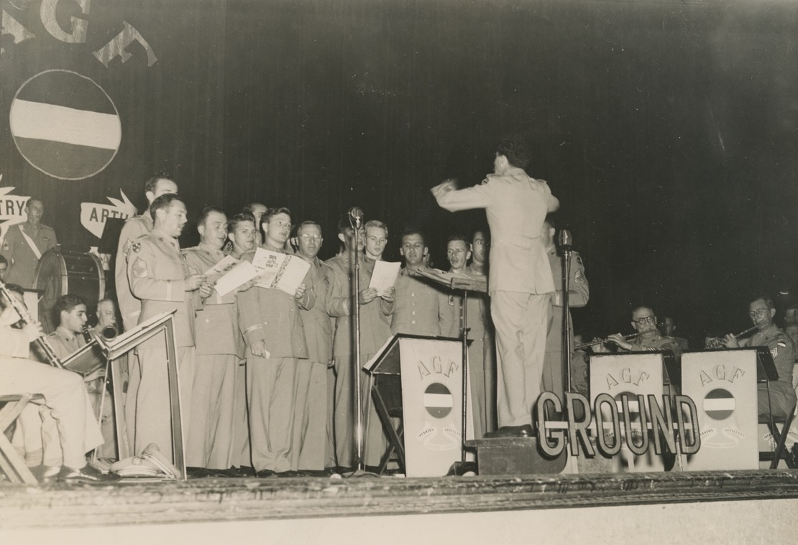
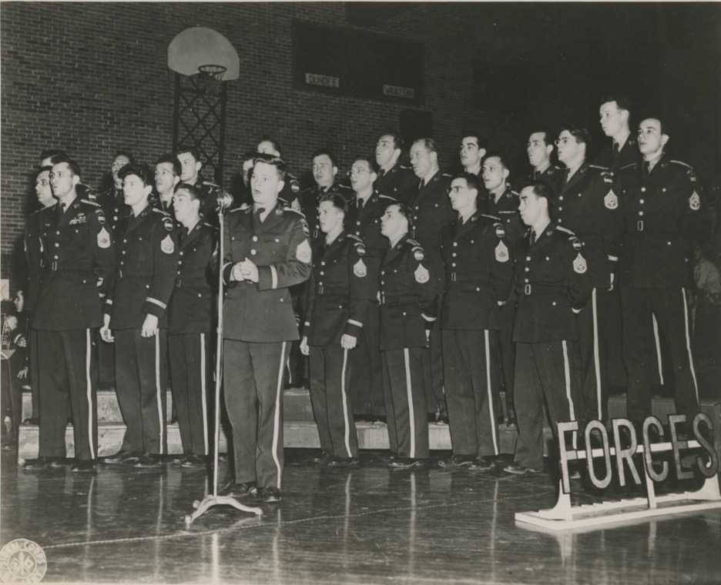

Slide 16
1950: the Army Ground Forces Band is re-designated The United States Army Field Band.
-The name change reflects the restructuring of the Army’s major commands:
-During WWII: Army Ground Forces, Army Air Forces, Army Service Forces…
-In 1948, Army Ground Forces becomes Army Field Forces…
-In 1955 it becomes CONARC and in 1973 splits into FORSCOM and TRADOC
Numerous other names are considered for the band, including:
Army of United States Band
The Army Parade Band
The Soldiers’ Band
The US Army Field Forces Band
The US Army Caravan of Music (yikes)
United Forces Band
Army Combat Band
Army Combat Forces Band
Army Service Band
Army Concert Band etc.

Slide 17
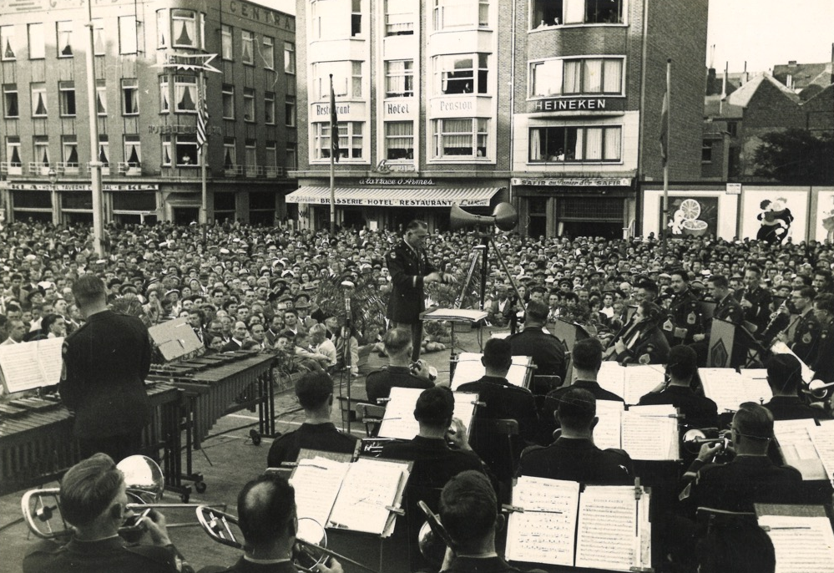
The band continues touring the US, and conducts three international tours:
-1952 European Tour (Scotland, England, Germany, Austria, Belgium, Netherlands, France, Luxembourg)
-1957 European Tour (UK, France, Spain, Portugal, Monaco, Italy, Yugoslavia, Austria, Germany, Luxembourg, Belgium, Netherlands)
1st US band to perform in Yugoslavia (behind the “iron curtain,” aka USSR, at the time)
-1958 Southeast Asia Tour (Hawaii, Korea, Okinawa, Japan)
(Right) Luxembourg City bandstand, 1952

Slide 18
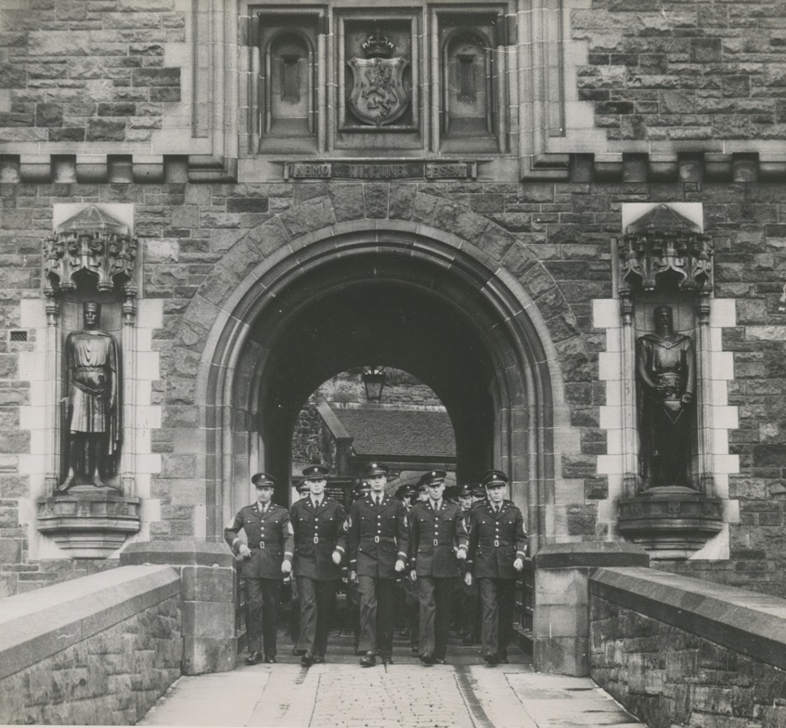
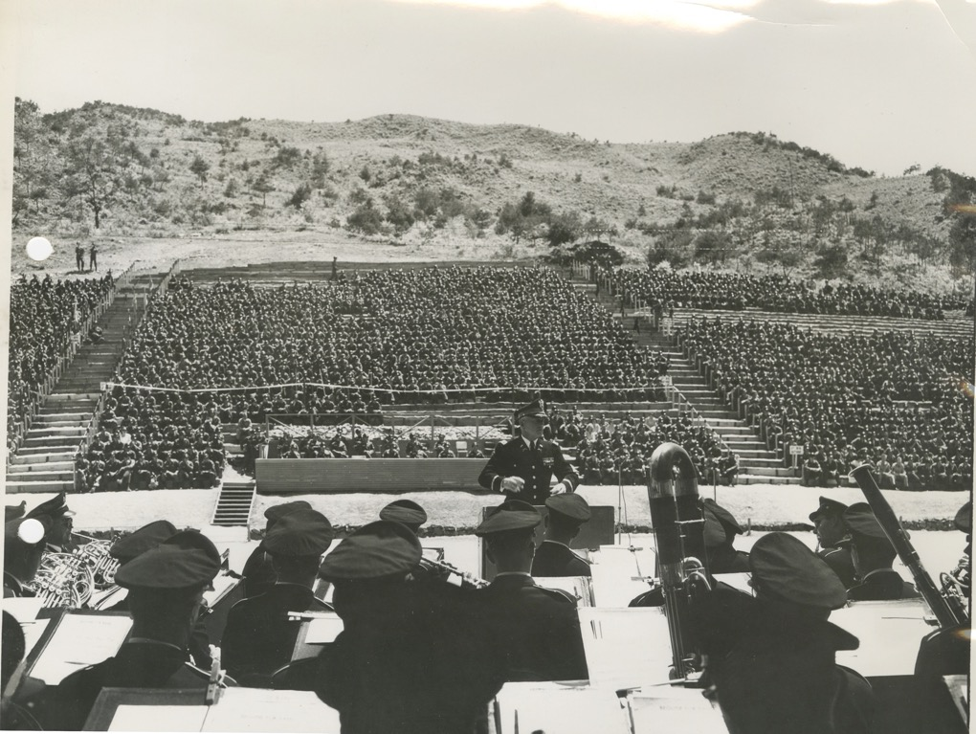
(Above) Edinburgh Castle, 1952
(Above) The 7th Infantry Division “Bayonet Bowl,” Korea, 1958

Slide 19
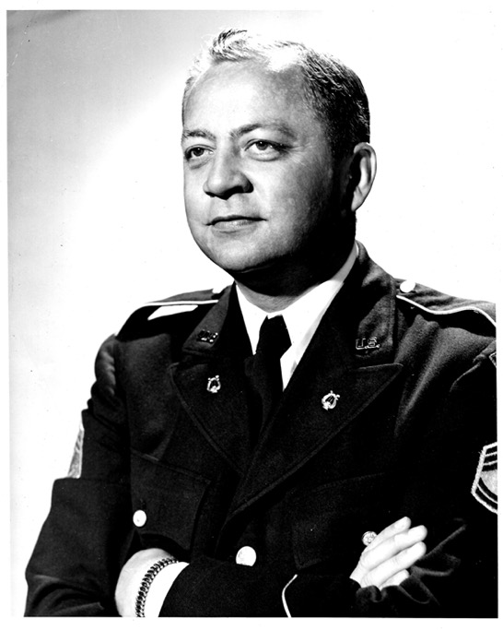
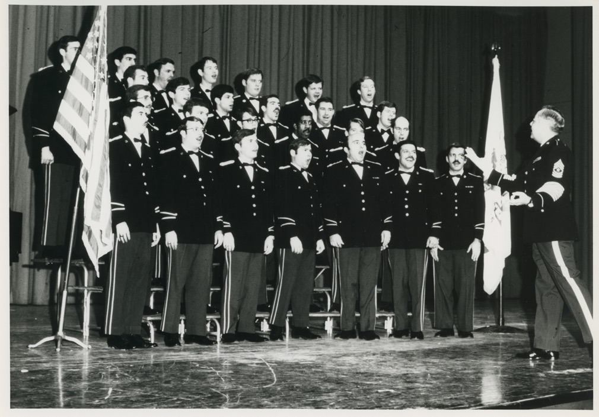
By the end of the 1950s, the Soldiers’ Chorus, under the direction of SGM Gene Coughlin, has dedicated personnel positions, is hiring professional vocalists, and is considered its own component.

Slide 20
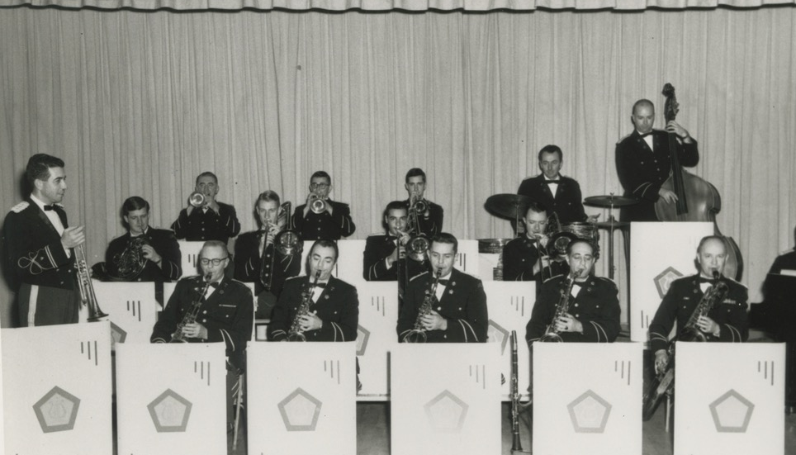
1960: Chester E. Whiting retires and passes the baton to Robert Bierly.
1960s: Jazz comes to the forefront as the “Kings of the Road” big band/dance band is created. By the end of the decade (1969) a 3rd official touring component is formalized – the STUDIO BAND.
(Above) The Kings of the Road under Sam Fricano
(Right) The early Studio Band under Charlie Almeida

Slide 21
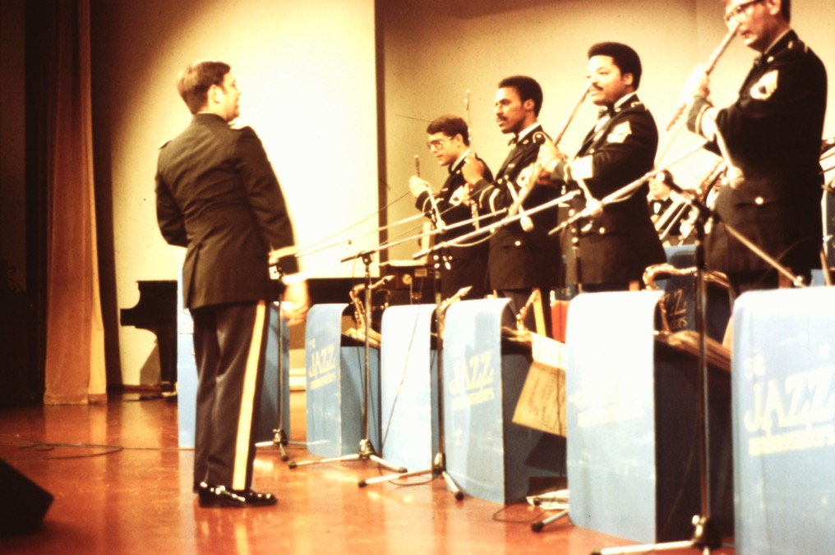
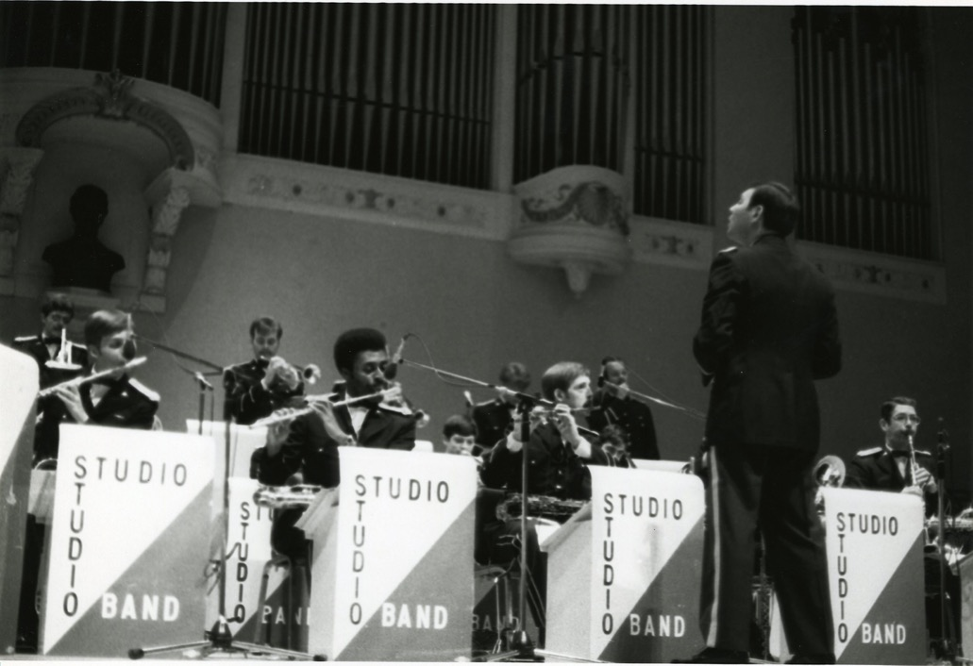
Paul Chiaravalle directed the Studio Band before and after its name change to the Jazz Ambassadors.

Slide 22
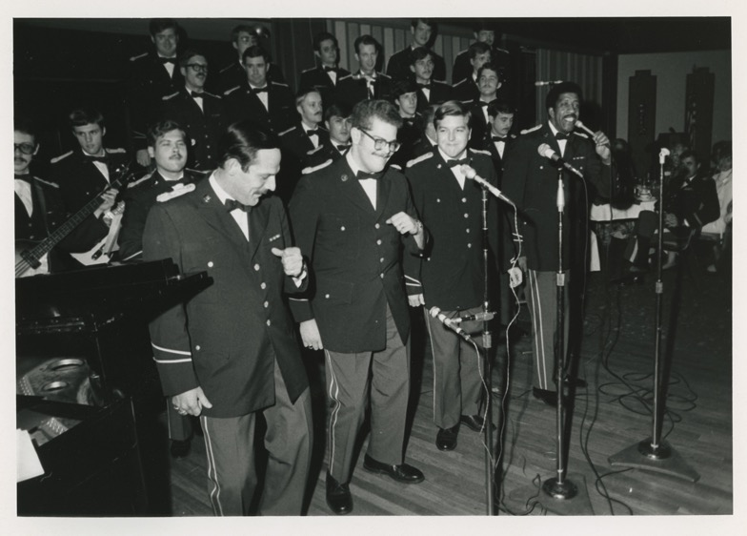
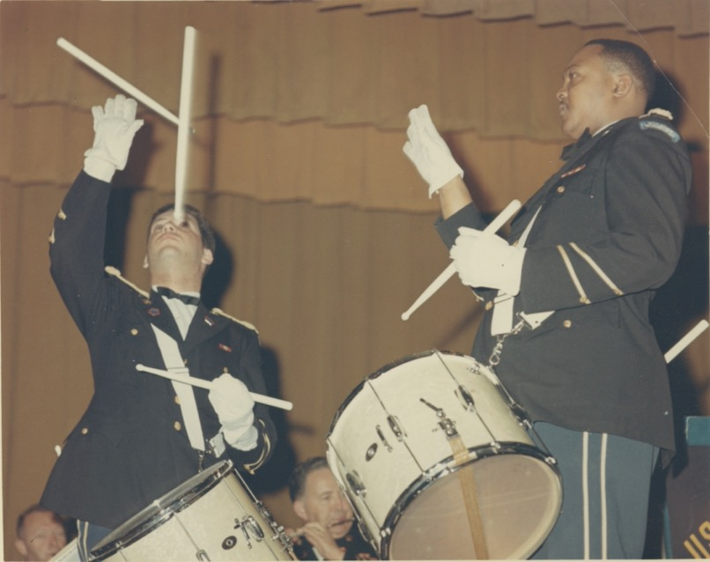
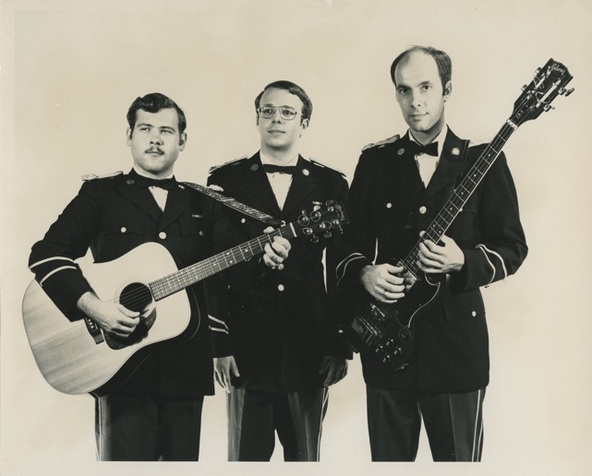
- Vocal small groups flourish (the Four Hits, the Overland Singers, the Volunteers) laying the foundation for the future 4th performing component of the Field Band.
- During divided time in US history (Vietnam, fight to end segregation), the CB & SC, and Studio Band tour the nation and are effective at using the language of music to bring people together.
- 1963: the first African American Soldiers join the Field Band: Quint Bowles and Bob Throne.

Slide 23
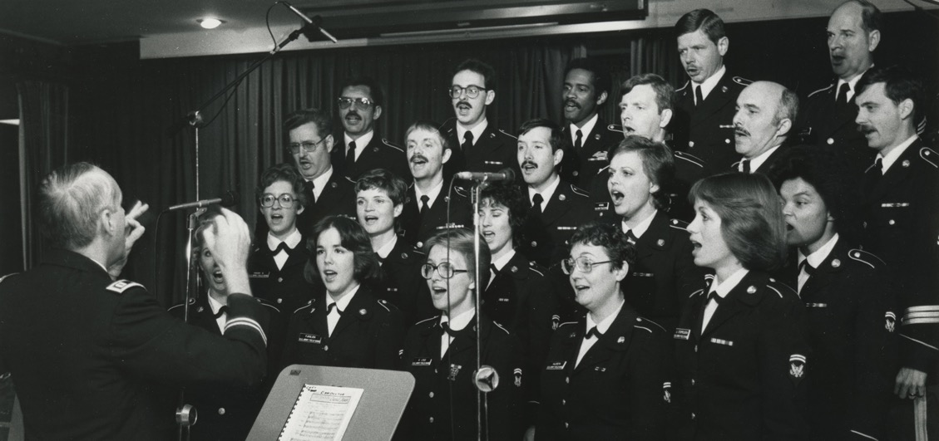
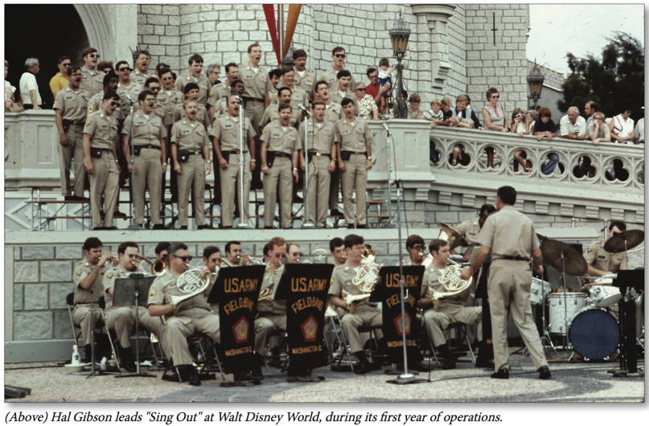
1970 Latin American Tour (Guatemala, Nicaragua, Costa Rica, Panama, Canal Zone, Ecuador, Columbia, Venezuela, Puerto Rico, St. Croix, St. Thomas (US Virgin Islands))
1972-74: “Sing Out for America” tours with the SB & SC, and the Volunteers.
1973: The SC conducts 1st cross country tour WITHOUT the band – a 23 day trip which includes a performance with the Women’s Army Corps Band for the funeral of Lyndon B. Johnson.
1974: The Women’s Army Corps is phased out (1978). The Field Band begins hiring women in 1974 and the Soldiers’ Chorus becomes a professional mixed chorus.
1978: the Studio Band is re-named the Jazz Ambassadors.

Slide 24
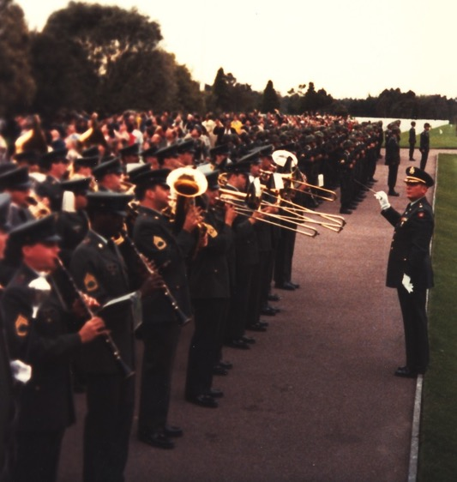
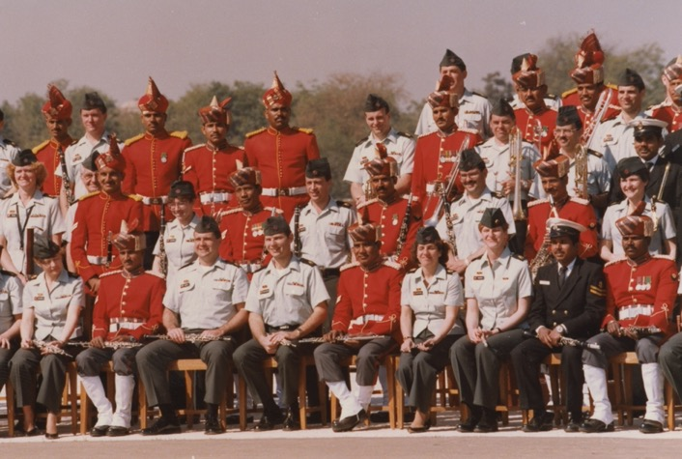
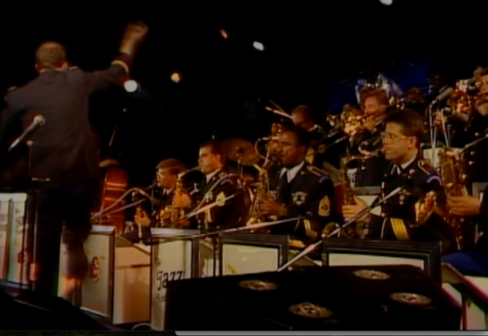
Early 1980s: The Volunteers are re-booted as a rock band and become the 4th official touring component.
1984 European Tour (D-Day 40th): Holland, Belgium, Germany, France (including ceremonies at Omaha Beach and
Pointe du Hoc)
1985 - Alaska
1987 – Germany (750th of founding of Berlin, Bicentennial of US Constitution), Korea and Japan
The unit receives its first Superior Unit Award for this trip. (This is shortly before the fall of the Berlin Wall)
1989 – India (CB, SC, and JAs)
1989 – Jazz Ambassadors European Tour (Germany, France, Italy, Holland, Belgium, Switzerland (1st military group to perform on the mainstage at Montreux Jazz Festival))

Slide 25
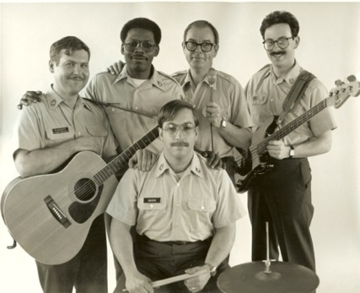
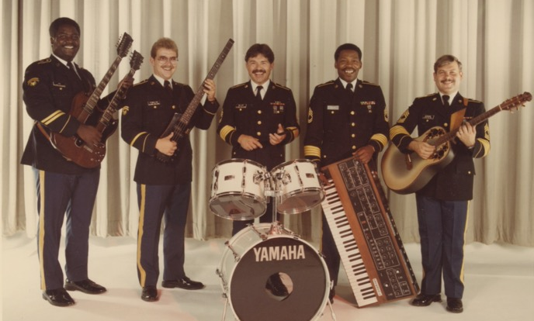
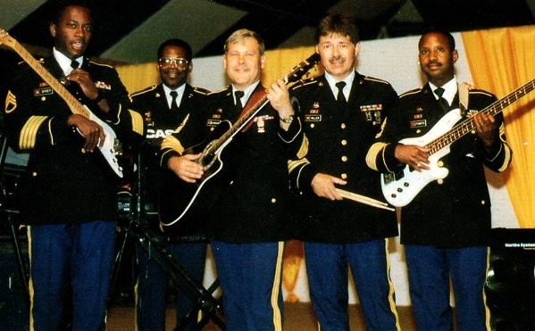
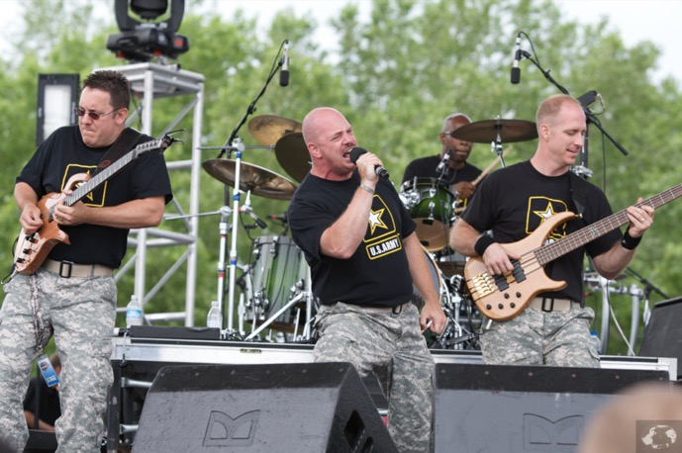
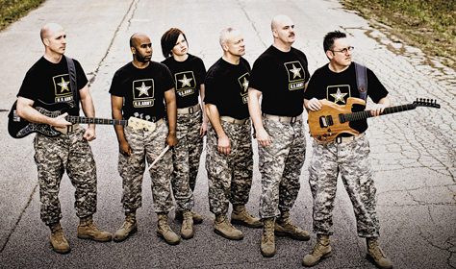

Slide 26
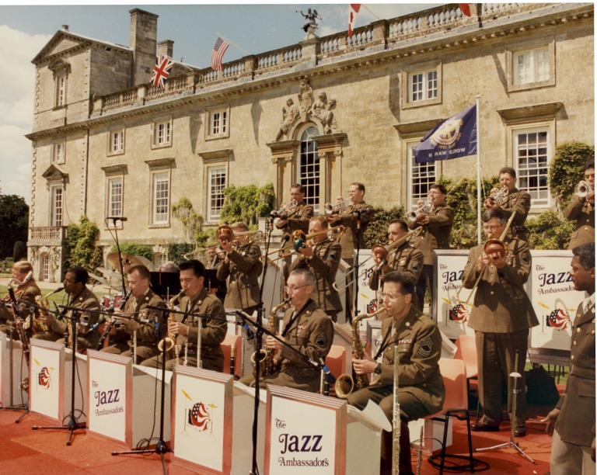
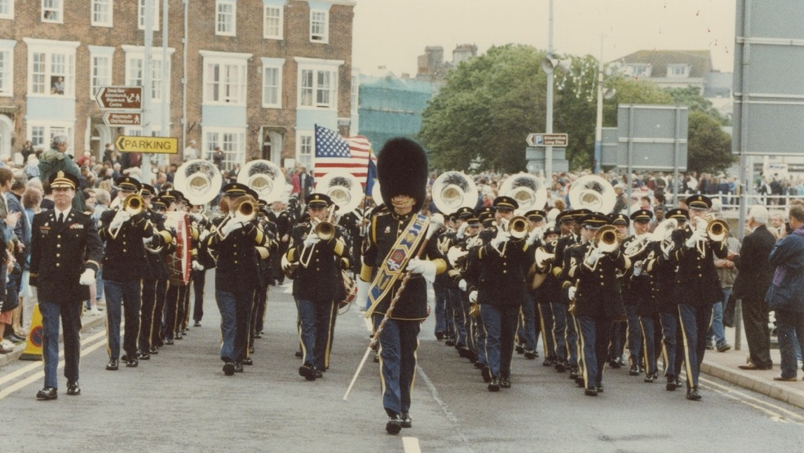
1991: For extensive touring in support of Operation Desert Storm, the band receives its second Army Superior Unit Award.
1992: JAs to Mexico – 11 performances in 7 cities
1993: JAs to Japan – 10 day trip incl. opening of Glenn Miller Birthplace Society in Tokyo.
1994: Europe (D-day/WWII 50th commemorations): UK, Belgium, Luxembourg, Germany.
1996: The unit celebrates its 50th anniversary (see 50th anniversary video online).

Slide 27
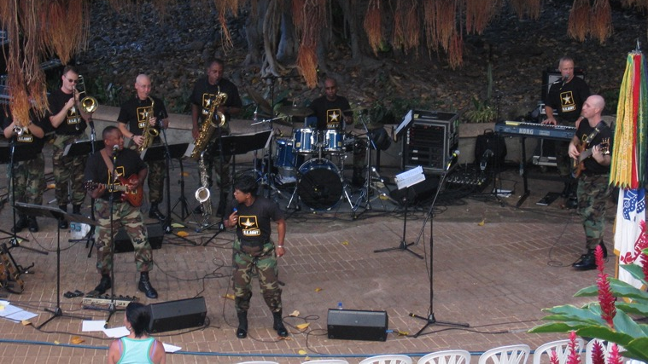
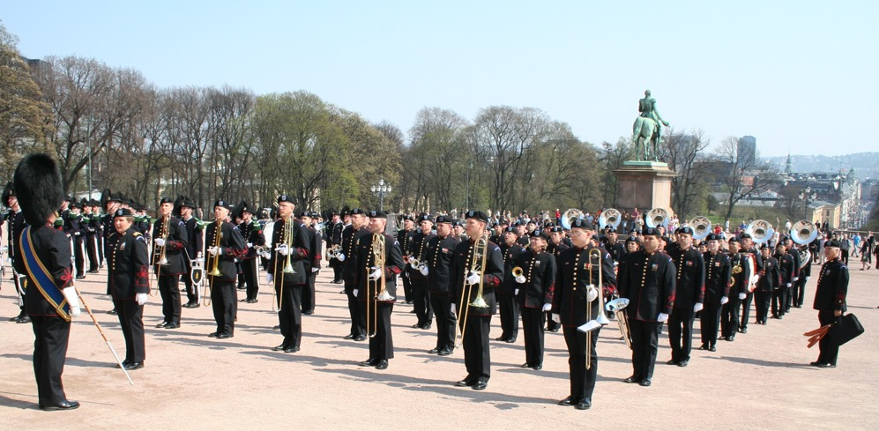
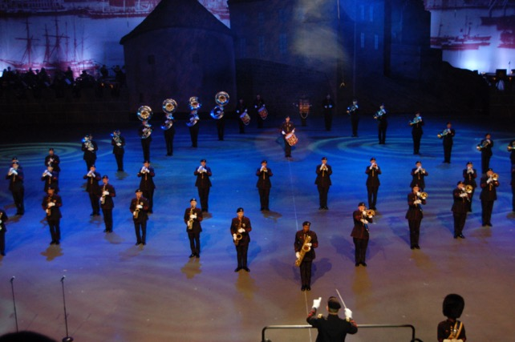
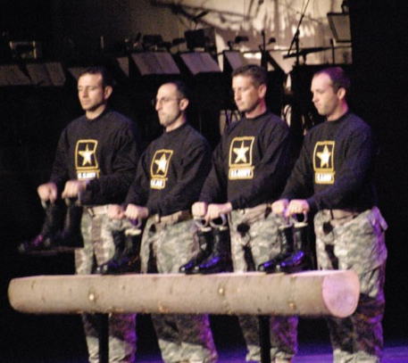
2000, 2006: Norwegian Military Tattoo in Oslo
2001, 2004: Alaska
2005: Hawaii (VOLS and some from JAs)
Midwest Clinic in Chicago
(Above) Hawaii, 2005
(Above & Right) Oslo, Norway, 2006

Slide 28



2008, 2011, 2015, 2021: Midwest Clinic
2015: Volunteers ----> Six String Soldiers
2018: Soundtrack of the American Soldier album
2018: Norwegian Military Tattoo, Oslo
Soldiers’ Chorus (Cantare) to Puerto Rico
(Left) Skywalker Sound, 2018

Slide 29


JAs at Boardman Park Ampitheater, 2011
B&C at Chautauqua Ampitheater, 2010

Slide 30

Greenfield Village, Detroit, 2015

Slide 31


(Left) 2017 Inaugural Parade
(Right) Boston, 2017

Slide 32


(Left) Norwegian Military Tattoo, 2018
(Below) SC members in Puerto Rico, 2018

Slide 33

2021: The unit celebrates its 75th anniversary
2022: Royal Edinburgh Military Tattoo
2024: Basel and Hamina Tattoos
[2024]: The unit receives its 3rd superior unit award

Slide 34


(Right) Boston, 2023
(Left) JAs at Toronto Jazz Festival, 2023

Slide 35



(Above) Basel, 2024
(Above & left): Hamina, 2024

Slide 36
For deeper dives into TUSAFB history, see:
In depth articles on website:
-75th anniversary historical highlights
-WWII origins of the Field Band
-Origins of the Soldiers’ Chorus
-Origins of the Jazz Ambassadors
2 x 1 hr videos, also on the site:
-50th anniversary video (1996)
-75th anniversary video
Mike Culbertson:
-Kings of the Highway 2024
Joe Levine:
-A Photo History of the US Army Field Band
-R&AA Newsletter Archive, 1992-2006
(above available on Lulu.com)
Chester E. Whiting’s autobiography,
-The Baton and the Pendulum

